Slide 1
Introduction to rotations
Transformations

Slide 2
how to use Oak lessons

Slide 3
I can understand the nature of rotations and appreciate what changes and what is invariant.

Slide 4
The object is the starting figure before a transformation has been applied.
The image is the resulting figure after a transformation has been applied.
If one shape can fit exactly on top of another using rotation, reflection or translation, then the shapes are congruent.
A property of a shape is invariant if that property has not changed after the shape is transformed.

Slide 5
The rotation of an object is the turning of an object by a fixed amount and around a fixed point (called the centre of rotation), without the image being flipped or its size changing.

Slide 6

Introduction to rotations
Identifying rotations in the real world
Understanding properties of rotations

Slide 7
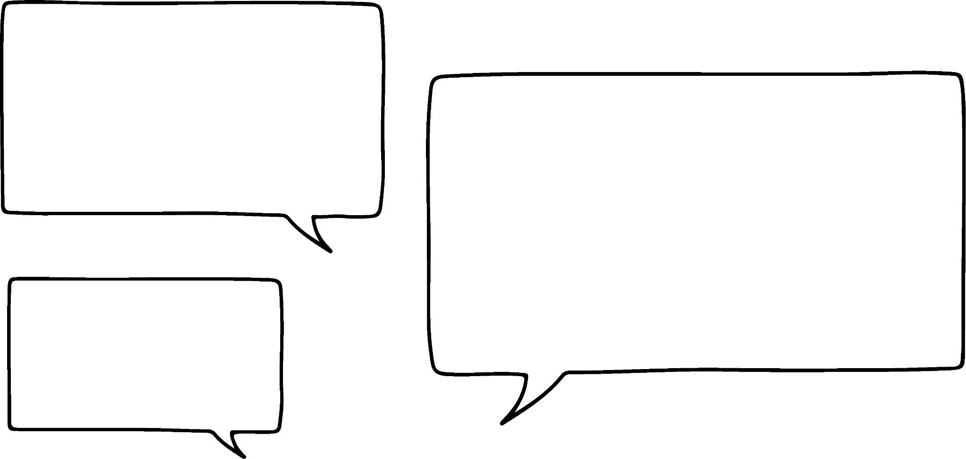


Identifying rotations in the real world
So turning a key to lock a door is the same as rotating a key to lock a door!
What other words mean rotate?
All these words describe the same action as rotating:
turn
spin
revolve

Slide 8
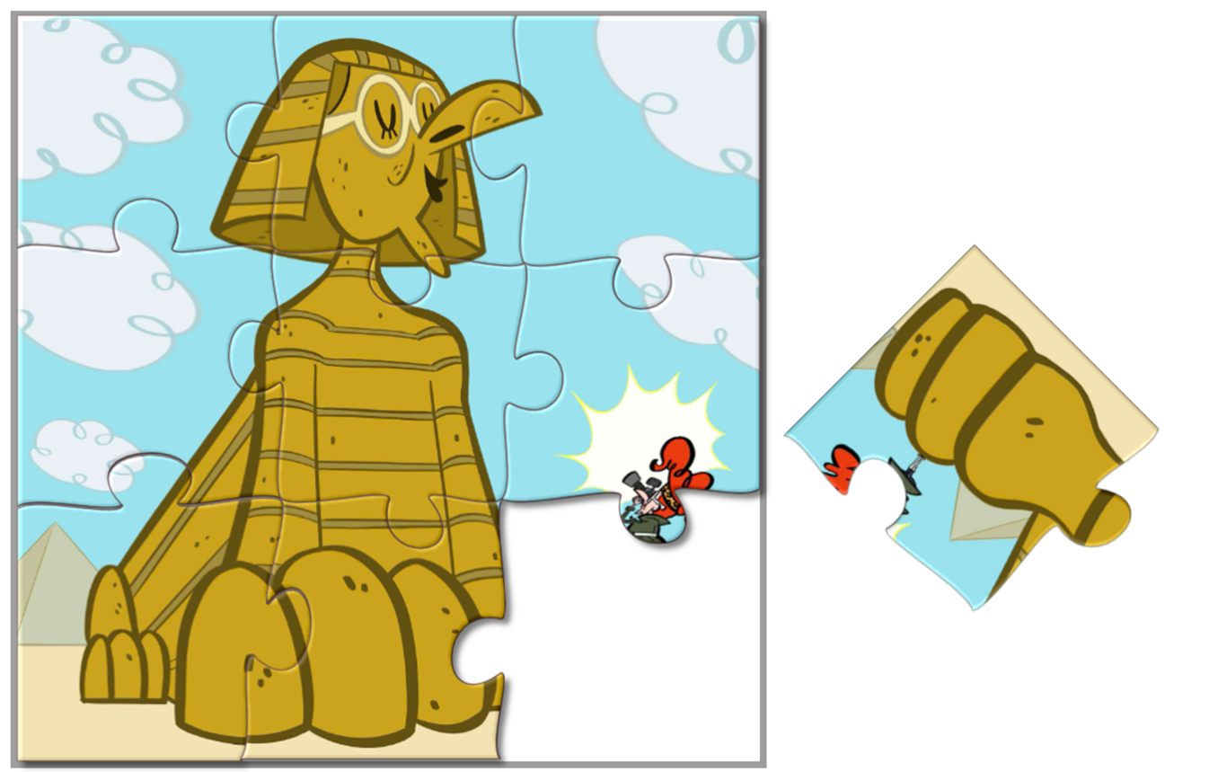


Identifying rotations in the real world
Rotations are useful everywhere in the world.
You will have rotated things without even realising it.
For example, you cannot complete this jigsaw puzzle if you only translate the missing piece.
rotate
You have to rotate it first so it fits in with the rest of the puzzle.

Slide 9
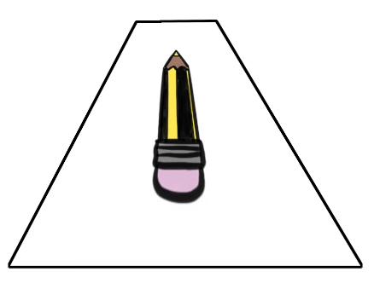

Identifying rotations in the real world
Get a pencil.
Lie it flat on the table with the tip (the part you write with) pointing away from you.
The pencil cannot be lifted off of the table.
Rotate your pencil so that the tip is now pointing left.
In how many ways can you do this?
There are infinite possibilities for this rotation.
The easiest way is to perform a quarter-turn .

Slide 10
Identifying rotations in the real world
Place your pencil so the tip is pointing away from you again. The pencil must stay touching the table.
Rotate your pencil so that the tip is now pointing right.
Can you do this in two different ways?
Can you describe what you’ve done?
There are infinite possibilities for this rotation.
The two easiest ways are to rotate it a quarter turn , or three-quarters .

Slide 11
Identifying rotations in the real world
Get a pencil.
Lie it flat on the table with the tip (the part you write with) pointing away from you.
The pencil cannot be lifted off of the table.
Rotate your pencil so that the tip is pointing towards the door. What is the most complicated rotation you can create to make this happen?
A complicated rotation could involve rotating it through multiple full turns before stopping with the point towards the door.

Slide 12
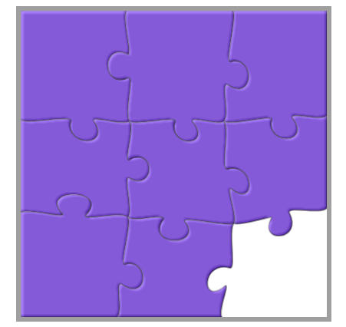
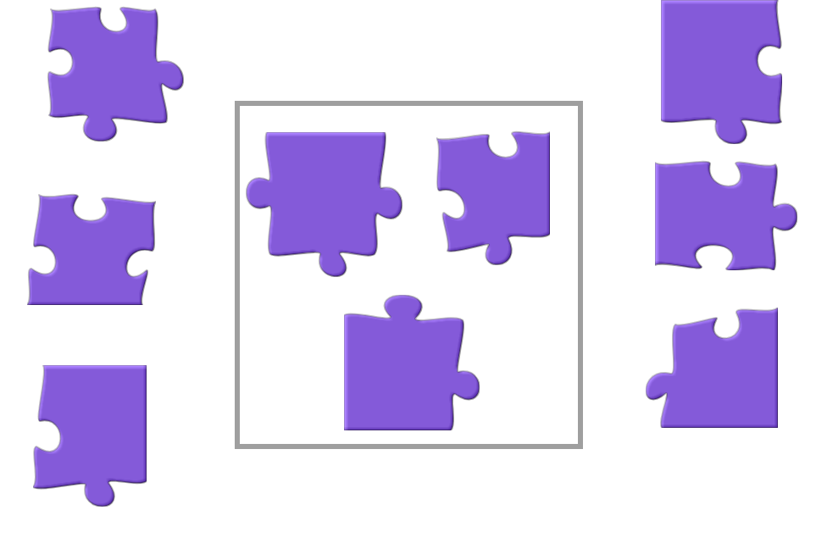

Identifying rotations in the real world
Which of these jigsaw pieces, when rotated, complete the jigsaw puzzle?
Can you describe what you have to do to that jigsaw piece to make it fit?
a
b
c
Rotate it a quarter turn.

Slide 13

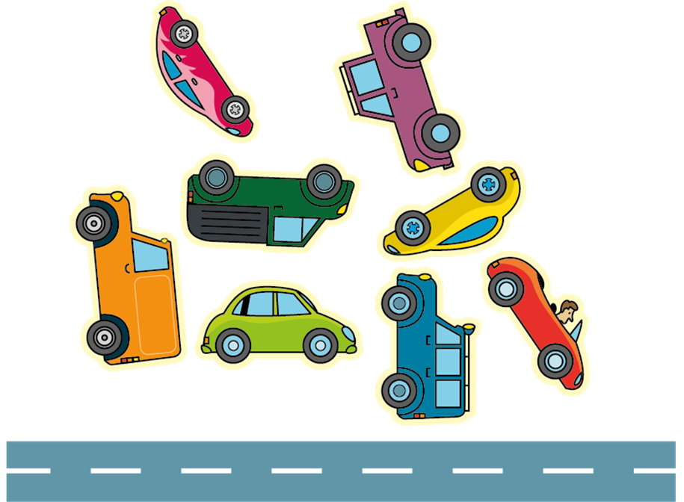
Identifying rotations in the real world
This car sticker is rotated so its wheels are on the road, which direction will the car be facing: left or right?
The car will be facing to the left.

Slide 14



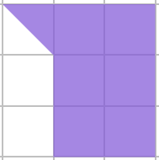
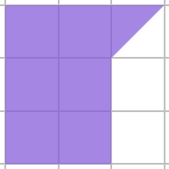
Identifying rotations in the real world
Which of the shapes below can you rotate and fit into the space of the shape to the right so that the result is a rectangle?
a
b
c
d

Slide 15
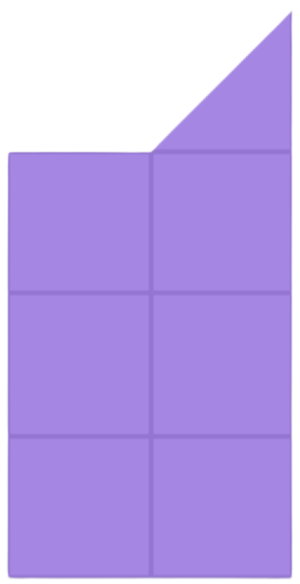
Identifying rotations in the real world
Which of the shapes below can you rotate and fit into the space of the shape to the right so that the result is a rectangle?
a
b
c
d

Slide 16

Identifying rotations in the real world
A
B
I want to rotate all these stickers so that when I stick them into my book, they’re all the right way up with their wheels on the road!
C
D
Laura
H
E
F
G
1) Which vehicles will be facing left, and which will be facing right?

Slide 17
Identifying rotations in the real world
2) Sketch your own vehicles in different orientations.
Can you draw two vehicles that face the same way, even though you have to rotate them differently?
A
B
C
D
H
E
F
G

Slide 18
Identifying rotations in the real world
A
B
I want to rotate all these stickers so that when I stick them into my book, they’re all the right way up with their wheels on the road!
C
D
Laura
H
1) Which vehicles will be facing left, and which will be facing right?
F
E
G
Left: A, B, C, E, G
Right: D, F, H

Slide 19
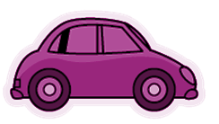
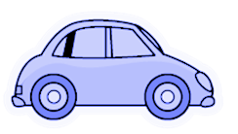
Identifying rotations in the real world
2) Sketch your own vehicles in different orientations.
Can you draw two vehicles that face the same way, even though you have to rotate them differently?
A
B
C
D
For example:
Both these cars face right when rotated.
H
E
F
G

Slide 20
Introduction to rotations
Identifying rotations in the real world
Understanding properties of rotations

Slide 21
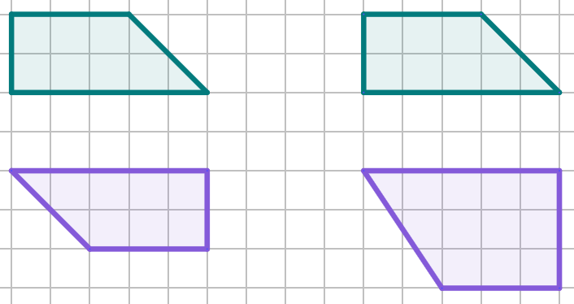
Understanding properties of rotations
When an object is rotated, the lengths of the sides are invariant, but the orientation of the sides changes.
Which of these is an example of a rotation and which is a non-example?
object
All sides remain the same length, but have been rotated through half a turn.
object
The height was 2 units in the object, but 3 units in the image.
This is not a rotation.
image
image
example of rotation
non-example

Slide 22
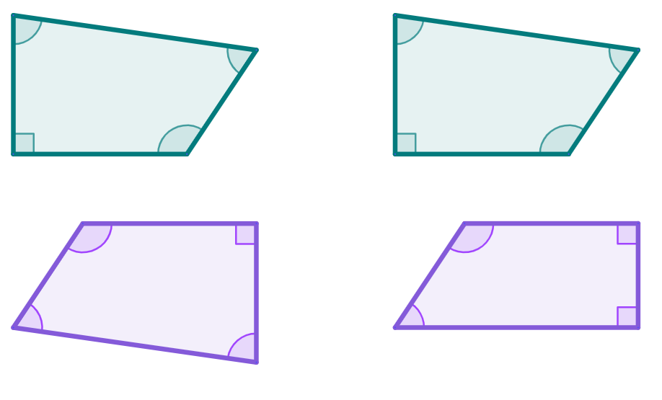





Understanding properties of rotations
When an object is rotated, the angles within the shape are always invariant.
Which of these is an example of a rotation, and which is a non-example?
object
object
image
image
example of rotation
non-example

Slide 23
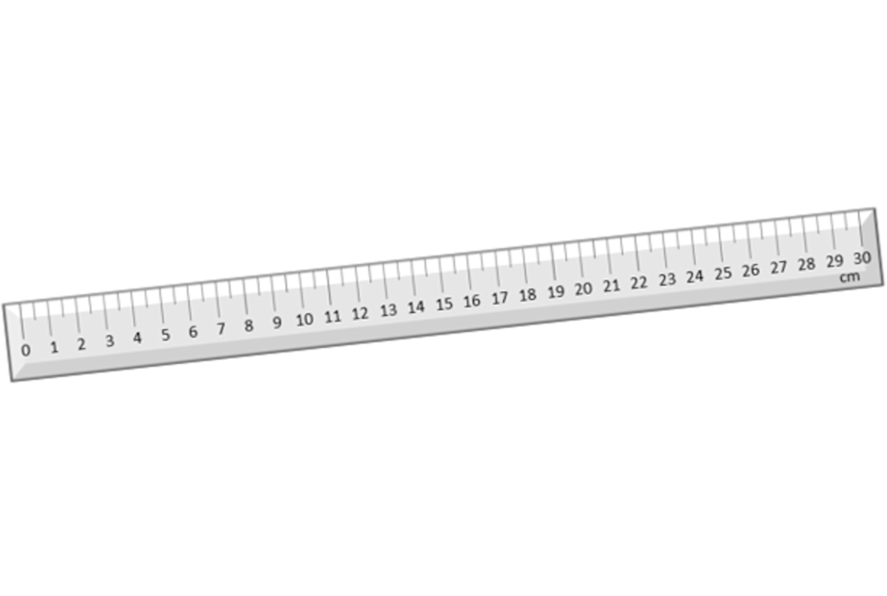
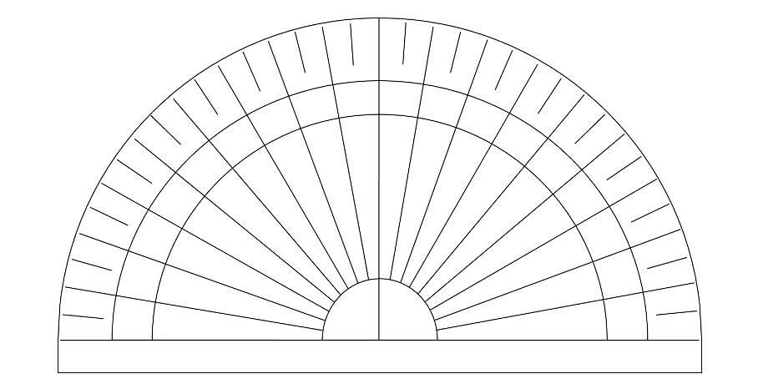
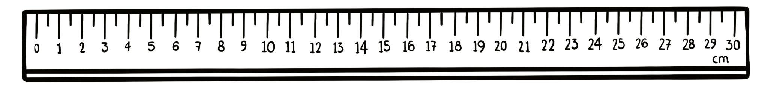
Understanding properties of rotations
For an image to be a rotation of its object, both the side lengths and angles must be invariant.
You can check if an image is a rotation by using:
a ruler to measure the sides
a protractor to measure the angles
Which of these images is not a rotation of the rectangle?
25.5 cm
22 cm
22 cm
22 cm

Slide 24
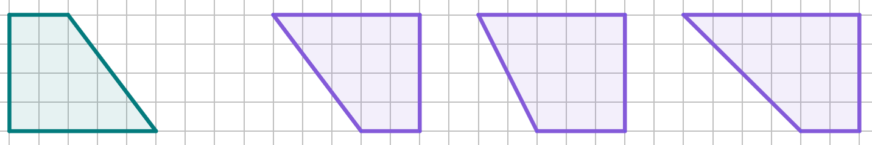
Understanding properties of rotations
Which of these images is a rotation of this trapezium?
a
b
c

Slide 25



Understanding properties of rotations
Sam
This rectangle has been rotated, because both the object and its image have the same side lengths.
Is Sam’s statement True or False?
T
True
F
False
3 cm
Justify your answer
object
a
Because the side lengths of 5 cm and 3 cm are invariant.
5 cm
5 cm
b
Because the angles in the shape have changed.
3 cm
image

Slide 26

Understanding properties of rotations
Objects that are rotated are not directly mirrors of their image.
This is easier to see with words on a piece of paper. The word ‘rotate’ still looks like the same word, even as it gets rotated.
ROTATE
ROTATE
ROTATE
ROTATE
ROTATE
ROTATE
ROTATE
However, when you mirror the word ‘rotate’ it no longer looks like the same word.
ROTATE

Slide 27
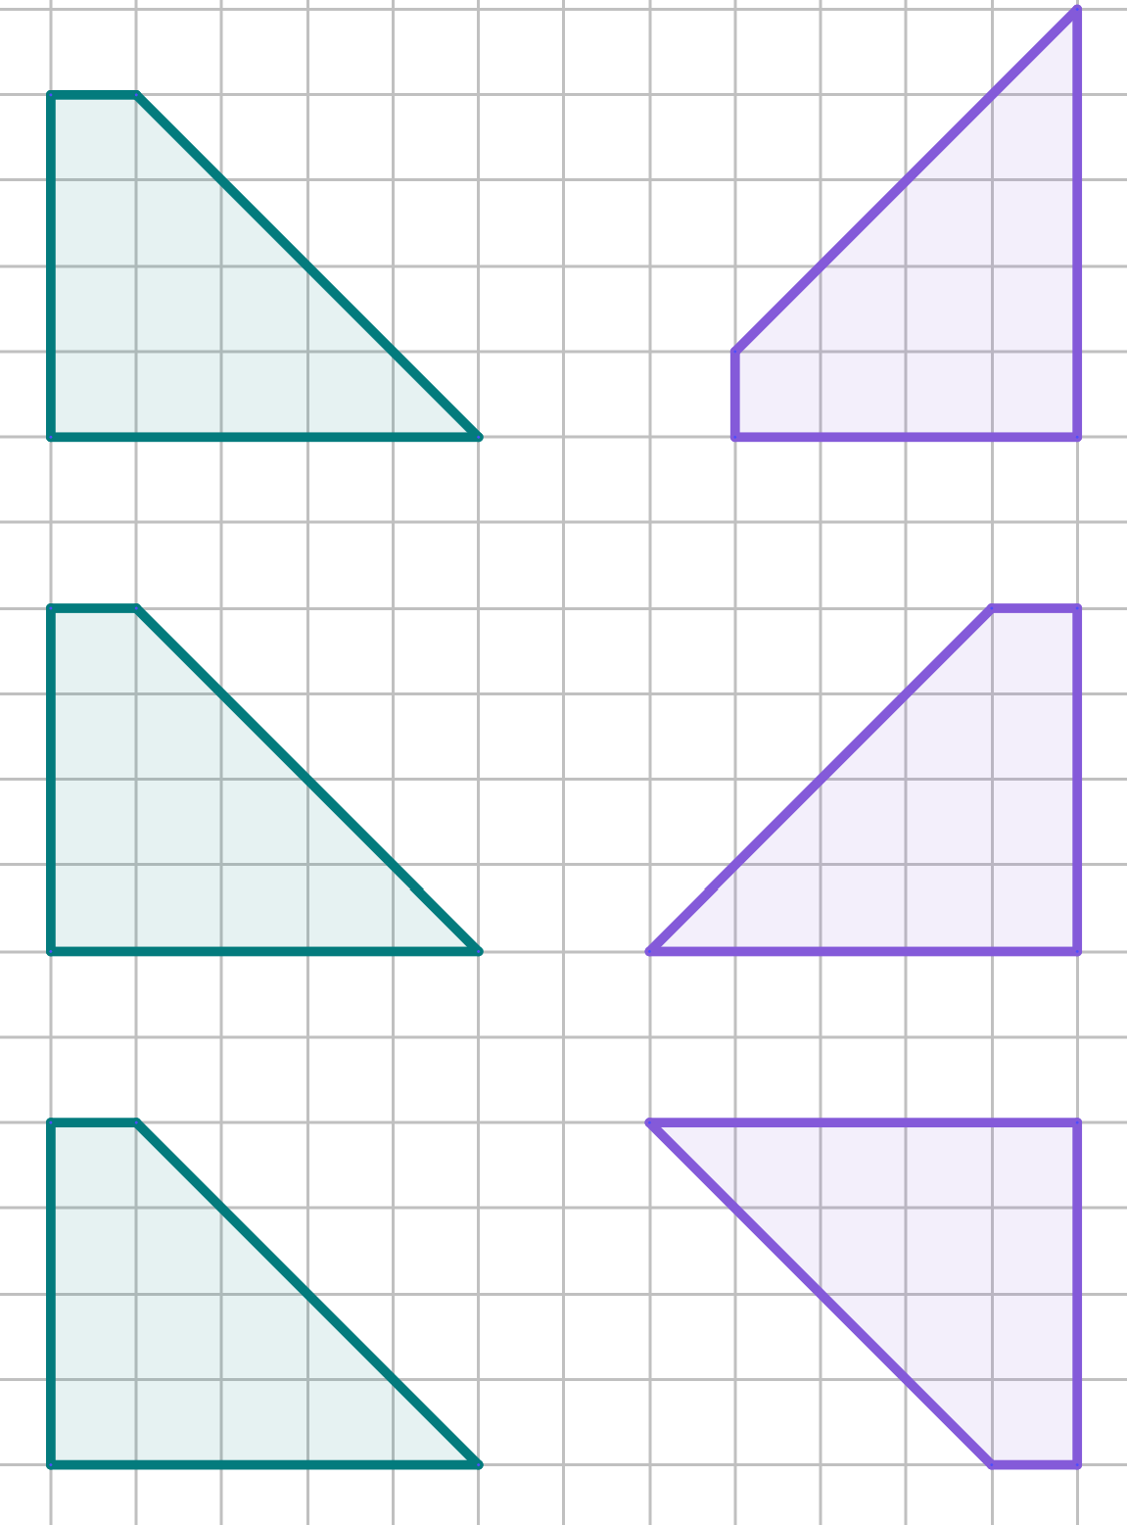
Understanding properties of rotations
Select all the objects that have been rotated to create its image.
objects
images
a
b
c

Slide 28
Understanding properties of rotations
When an object is rotated, its orientation changes, even if the image looks the same as its object.
object
image
D′
D′
D′
C′
D′
C′
D
C
C′
C′
This is easier to see if we label the vertices of the object and image.
A
B
A′
B′
A′
B′
A′
B′
A′
B′
object
image

Slide 29
Understanding properties of rotations
D′
C′
D′
D′
C′
D′
D′
C′
C′
D′
C′
D′
C′
D′
C′
D′
C′
C′
D′
C′
C′
C′
C′
D
C
D′
C′
D′
D′
D′
The only time orientation is invariant is when a full turn of rotation occurs.
A′
B′
A
B
A′
B′
A′
B′
A′
B′
A′
B′
A′
B′
A′
B′
A′
B′
A′
B′
A′
B′
A′
B′
A′
B′
A′
B′
A′
B′
object
image
Three quarter turns
One quarter turn
Half a turn
A full turn means the orientation of the object and image are invariant.

Slide 30


Understanding properties of rotations
As you rotate the arrow, it will start to point in a different direction and never point in the same direction.
After a full turn of rotation, it will return to the same orientation and point in the same direction.
Sofia
Lucas
Whose statement about the arrow is correct?

Slide 31
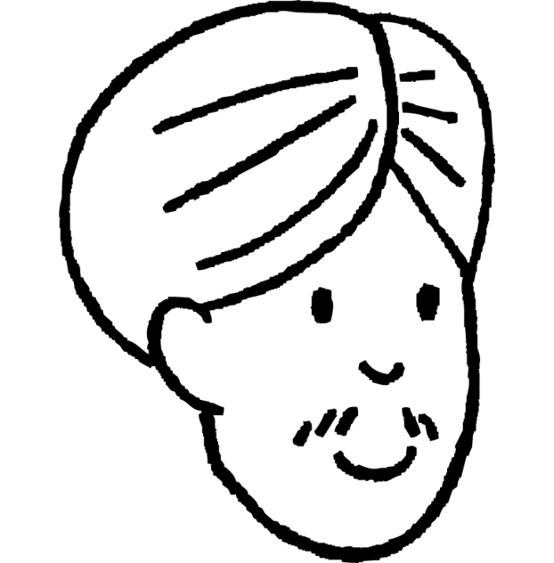
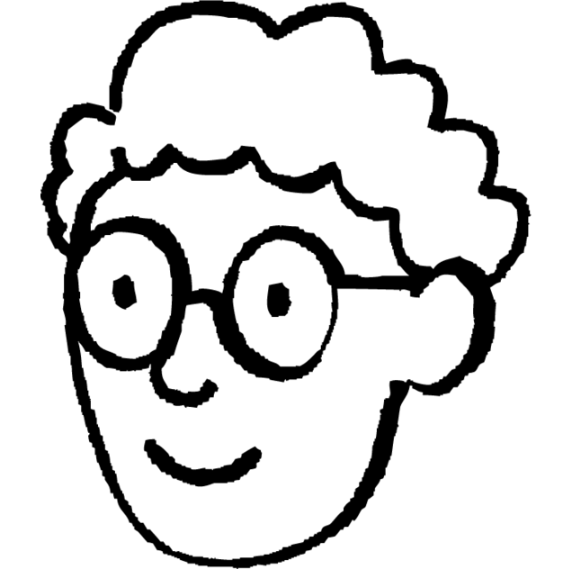
Understanding properties of rotations
I have rotated my shape!
No you haven’t!
object
image
Alex
Andeep
Alex’s statement is incorrect. Which of these may explain why.
a
The object has been rotated a full turn.
b
The image looks the same as the object.
c
The object has been rotated until it looks like it has the same orientation.

Slide 32
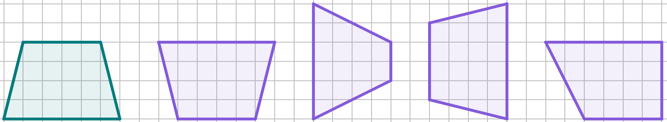

Understanding properties of rotations
1) Select all of the images which are rotations of this trapezium.
a
b
c
d
2) Using a ruler, draw a different correct rotation of the trapezium in the space given.
Draw your own

Slide 33
Understanding properties of rotations
3) The object and all images are rectangles.
Select all of the images which are rotations of this rectangle.
object
cm

Slide 34
Understanding properties of rotations
4) The object has been rotated to become the image.
Explain why Andeep might be incorrect.
The object and image both look the same, therefore they have the same orientation.
Andeep
object
image

Slide 35
Understanding properties of rotations
5) Complete the table with to show the properties of rotation.
 | Always Invariant | Usually Changes
Lengths of Sides
Size of Angles
Position
Orientation

Slide 36
Understanding properties of rotations
1) Select all of the images which are rotations of this trapezium.
a
b
c
d
Draw your own
2) Using a ruler, draw a different correct rotation of the trapezium in the space given.

Slide 37
Understanding properties of rotations
3) The object and all images are rectangles.
Select all of the images which are rotations of this rectangle.
object
cm

Slide 38
Understanding properties of rotations
4) The object has been rotated to become the image.
Explain why Andeep might be incorrect.
Object and image only have the same orientation if the object has been rotated through one full turn, or multiple full turns.
If it has been rotated by less than that, then the image may look invariant, but still have a different orientation.
The object and image both look the same, therefore they have the same orientation.
Andeep
object
image

Slide 39
Understanding properties of rotations
5) Complete the table with to show the properties of rotation.
 | Always Invariant | Usually Changes
Lengths of Sides
Size of Angles
Position
Orientation

Slide 40
Introduction to rotations
Placing rotation into real-world contexts can be helpful in identifying its purpose in solving puzzles and problems.
Understanding the properties of rotation is important in distinguishing between rotations and non-rotations.
Orientation is only preserved when a full-turn rotation (or multiple full-turn rotations) has occurred.

Slide 41

© Oak National Academy 2023.
Produced in partnership with Mathematics in Education and Industry
Licensed on the Open Government Licence v3.0, except where otherwise stated. See Oak terms and conditions.

